Slide 1
FILE I/O
APUE chapter 3
Section 3.1 to 3.8
Bharat Bhavsar
bmb140330

Slide 2
Introduction
One of the most important topic when we study UNIX.
How to open, read, write, edit file?
In this chapter we are going to learn different functions used in UNIX for file I/O.
These are known as unbuffered I/O in contrast to standard I/O.
To learn more about standard I/O please read APUE chapter 5.
Notes:
APUE Chapter 3 Page#61

Slide 3
Which function are we learning?
There are 5 functions that we are going to learn in this chapter
open
read
write
lseek
Lose
These are unbuffered function means that each read or write invokes a system call in the kernel.
As we are dealing with files, some operations of the operations should be atomic in nature to avoid any inconsistency
Notes:
APUE Chapter 3 Page#61

Slide 4
File Descriptors
To the kernel, all open files are referred to by file descriptors.
When we open an existing file or create a new file, the kernel returns a file descriptor to the process which is non-negative integer.
Default fil descriptor for UNIX
Standard input: 0
Standard output: 1
Error: 2
File descriptor range:
0 to OPEN_MAX−1
Notes:
APUE Chapter 3 Page#61 & 62

Slide 5
Function to ‘open’ file
2 functions are used:
open
openat
Definition:
#include <fcntl.h>
int open(const char *path, int oflag, ... /* mode_t mode */ );
int openat(int fd, const char *path, int oflag, ... /* mode_t mode */ )
Parameters:
path: name of the file with path
mode_t mode: mode in which user want to open the file. (Please go through Page# 62, 63 & 64 for details on different modes)
Notes:
APUE Chapter 3 Page#62 to 64

Slide 6
Function to ‘open’ file …continued
fd parameter distinguishes the ‘openat’ function from the ‘open’ function with 3 possibilities:
path parameter specifies an absolute pathname then fd parameter is ignored and the openat function behaves like the open function.
path parameter specifies a relative pathname and the fd parameter is a file descriptor that specifies the starting location in the file system where the relative pathname is to be evaluated.
path parameter specifies a relative pathname and the fd parameter has the special value AT_FDCWD. In this case, the pathname is evaluated starting in the current working directory and the openat function behaves like the open function
Notes:
APUE Chapter 3 Page#64 & 65

Slide 7
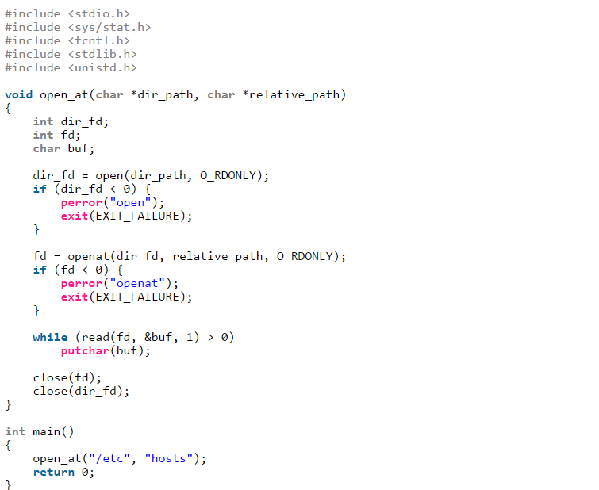
Example code:

Slide 8
How to create file?
Definition:
#include <fcntl.h> int creat(const char *path, mode_t mode); Returns: file descriptor opened for write-only if OK, -1 on error
Note that this functions is similar to the open function:
in early versions of the UNIX System, the second argument to open could be only 0, 1, or 2. There was no way to open a file that didn’t already exist. Therefore, a separate system call, creat, was needed to create new files. With the O_CREAT and O_TRUNC options now provided by open, a separate creat function is no longer needed
One can only write to file once it is created with creat function. To read the file, we have to first close the file and then open it in read mode.
Notes:
APUE Chapter 3 Page#66

Slide 9
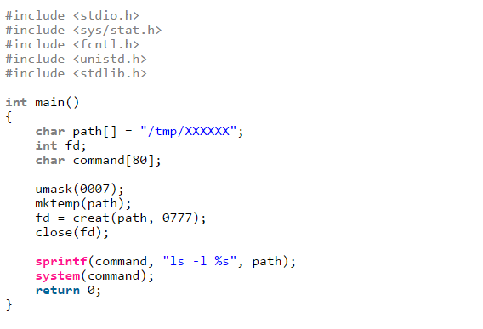
Example code:

Slide 10
How to close file?
Definition:
#include <unistd.h> int close(int fd);
Any record locks that the process may have on the file are released once it is closed.
When a process terminates, all of its open files are closed automatically by the kernel.
Many programs take advantage of this fact and don’t explicitly close open files.
Notes:
APUE Chapter 3 Page#66

Slide 11
What is lseek function?
“Current file offset” is associated with any open file, a non-negative integer that measures the number of bytes from the beginning of the file.
By default, this offset is initialized to 0 when a file is opened, unless the O_APPEND option is specified.
lseek is used to set the offset of open file explicitly.
Definition:
#include <unistd.h> off_t lseek(int fd, off_t offset, int whence); Returns: new file offset if OK, −1 on error
Notes:
APUE Chapter 3 Page#66 to 70

Slide 12
What is lseek function? …continue
offset depends on the value of the whence argument
If whence is SEEK_SET, the file’s offset is set to offset bytes from the beginning of the file
If whence is SEEK_CUR, the file’s offset is set to its current value plus the offset. The offset can be positive or negative.
If whence is SEEK_END, the file’s offset is set to the size of the file plus the offset. The offset can be positive or negative.
Normally, a file’s current offset must be a non-negative integer. It is possible, however, that certain devices could allow negative offsets.
lseek only records the current file offset within the kernel—it does not cause any I/O to take place.
Notes:
APUE Chapter 3 Page#66 to 70

Slide 13
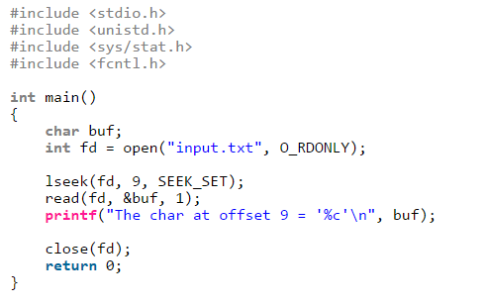
Example code: use SEEK_SET

Slide 14
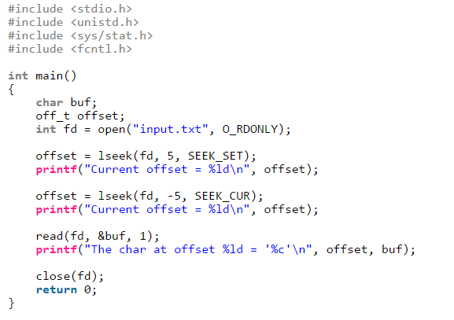
Example code: use SEEK_CUR

Slide 15
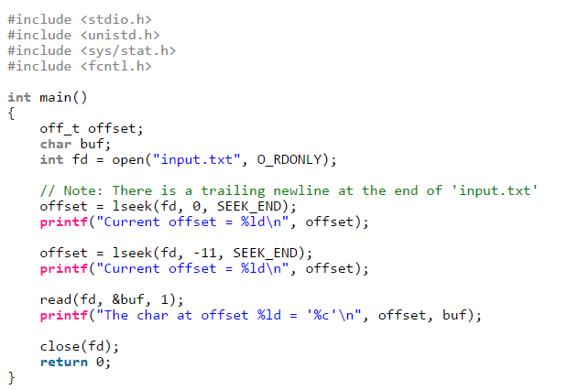
Example code: use SEEK_END

Slide 16
How to read file?
Definition:
#include <unistd.h> ssize_t read(int fd, void *buf, size_t nbytes); Returns: number of bytes read, 0 if end of file, -1 on error
If the read is successful, the number of bytes read is returned. If the end of file is encountered, 0 is returned.
You can encounter several different return scenarios from read function. Please read all those scenarios from book.
The read operation starts at the file’s current offset. Before a successful return, the offset is incremented by the number of bytes actually read.
Notes:
APUE Chapter 3 Page#71

Slide 17
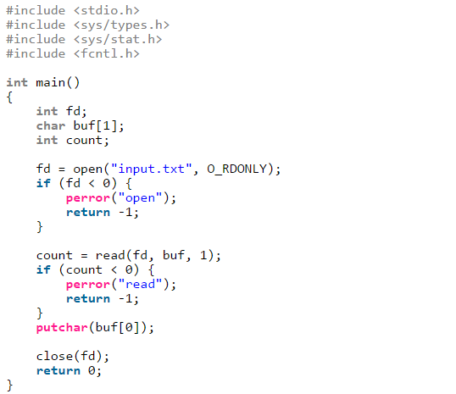
Example code: read existing file

Slide 18
How to write to the file?
Definition:
#include <unistd.h> ssize_t write(int fd, const void *buf, size_t nbytes); Returns: number of bytes written if OK, -1 on error
The return value is usually equal to the nbytes argument; otherwise, an error has occurred.
A common cause for a write error is either filling up a disk or exceeding the file size limit for a given process.
For a regular file, the write operation starts at the file’s current offset. If the O_APPEND option was specified when the file was opened, the file’s offset is set to the current end of file before each write operation.
After a successful write, the file’s offset is incremented by the number of bytes actually written.
Notes:
APUE Chapter 3 Page#72

Slide 19
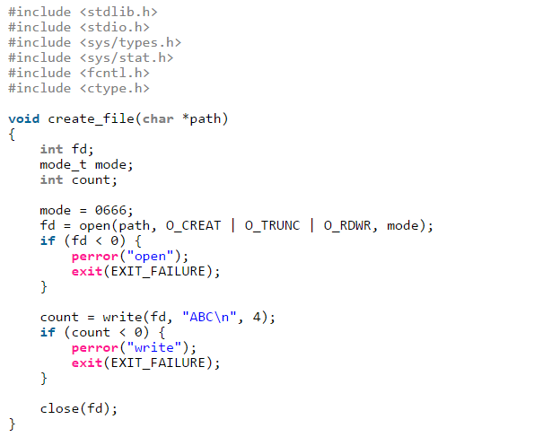
Examples code: create file and write

Slide 20
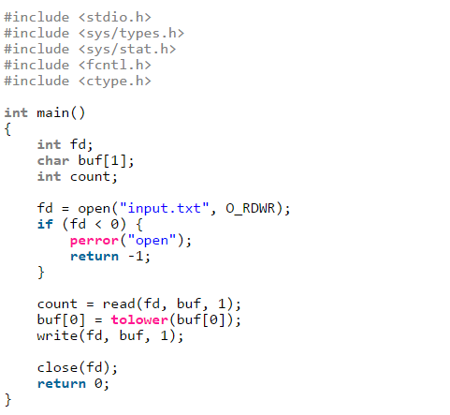
Example code: open existing file to write

Slide 21
Summery
So during this presentation we learned basic functions that are used with file I/O
To open file:
open()
openat()
To create file:
creat()
To close file:
close()
To read file:
read()
To write to file:
write()
To find/set offset of file:
lseek()
Notes:
Note: for detailed learning please read chapter 3 of APUE

Slide 22
What next you should read?
This is just a basic of file I/O handling overview.
Once you are comfortable with this, you can start learning following:
File sharing
I/O Efficiency
Atomic operations on file
dup/ dup2
Where to find these?
APUE chapter 3 section 3.9 onwards

Slide 23
THANK YOU!

